Slide 1
CS209: Computer Science II

Slide 2
Unit 1 Module 4:
Arrays of Objects
Arrays of Objects
Accessing Objects in the Array
Classes and Dynamic Arrays
Using unique_ptr with a Dynamic Object
The StringVar Class example

Slide 3
Arrays of Objects
Objects can be the elements of an array:
InventoryItem inventory[40];
Default constructor for object is used when array is defined

Slide 4
Arrays of Objects
class InventoryItem
{
private:
string description; // The item description
double cost; // The item cost
int units; // Number of units on hand
public:
// Constructor #1
InventoryItem()
{ // Initialize description, cost, and units.
description = "";
cost = 0.0;
units = 0; }

Slide 5
Arrays of Objects
// Constructor #2
InventoryItem(string desc)
{ // Assign the value to description.
description = desc;
// Initialize cost and units.
cost = 0.0;
units = 0; }
// Constructor #3
InventoryItem(string desc, double c, int u)
{ // Assign values to description, cost, and units.
description = desc;
cost = c;
units = u;
}

Slide 6
Arrays of Objects
Must use initializer list to invoke constructor that takes arguments:
InventoryItem inventory[3] = { "Hammer", "Wrench", "Pliers" };

Slide 7

Arrays of Objects
If the constructor requires more than one argument, the initializer must take the form of a function call:

Slide 8

Arrays of Objects
It isn't necessary to call the same constructor for each object in an array:

Slide 9
Accessing Objects in an Array
Objects in an array are referenced using subscripts
Member functions are referenced using dot notation:
inventory[2].setUnits(30);
cout << inventory[2].getUnits();

Slide 10
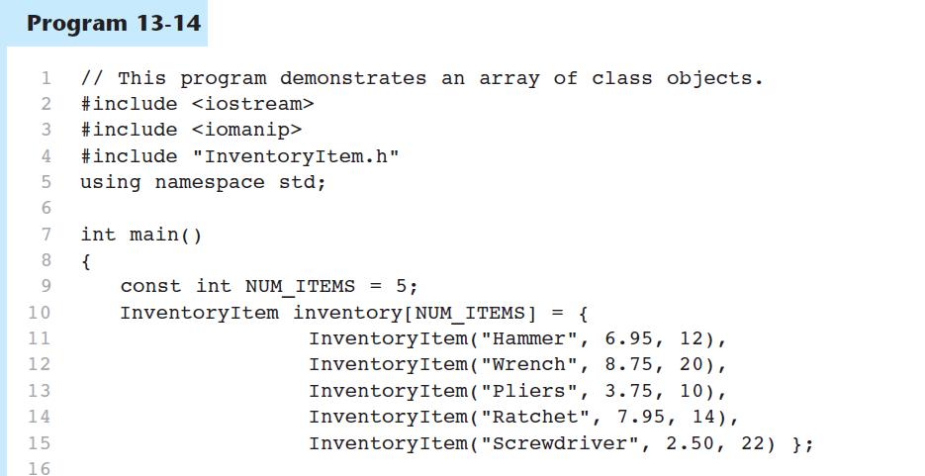
Accessing Objects in an Array

Slide 11
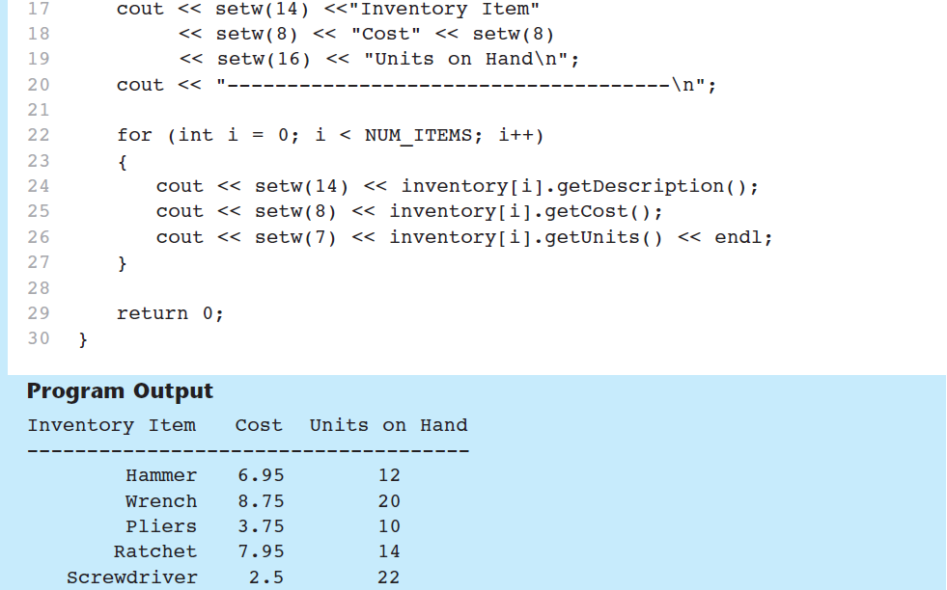
Accessing Objects in an Array
Program 13-14 (Continued)

Slide 12
Classes and Dynamic Arrays
A dynamic array can have a class as its base type
A class can have a member variable that is a dynamic array
If an exception occurs after successful memory allocation but before the delete statement executes, a memory leak could occur.
The C++ standard provides class template unique_ptr in header file <memory> to deal with this situation.

Slide 13
Classes and Dynamic Arrays
A unique pointer for an object keeps the pointer to the dynamically allocated memory
Unique pointers automatically delete the object when they go out of scope
And unique_ptr provides overloaded operators * and -> so that an unique_ptr object can be used just as a regular pointer variable is.
Avoid any possible memory leak
Only one unique_ptr at a time
Can transfer ownership of the memory

Slide 14
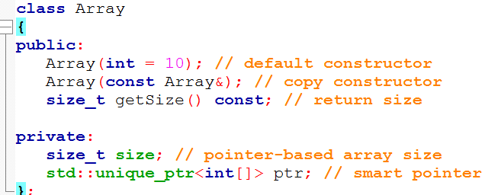
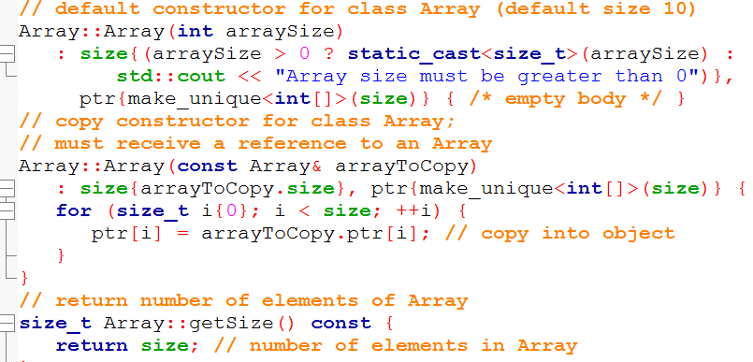
Classes and Dynamic Arrays
hpp
cpp

Slide 15
Unique _Ptr FYI
Because unique _ptr objects transfer ownership of memory when they are copied, they cannot be used with Standard Library container classes like vector.
Container classes often make copies of objects. This causes ownership of a container element to be transferred to another object, which might then be accidentally deleted when the copy goes out of scope.

Slide 16
The Integer Class definition
// Integer class definition.
class Integer
{
public:
Integer( int i = 0 ); // Integer default constructor
~Integer(); // Integer destructor
void setInteger( int i ); // functions to set Integer
int getInteger() const; // function to return Integer
private:
int value;
};

Slide 17
The Integer CPP
// Integer cpp – the member functions. (some code has been omitted for easier reading)
#include "Integer.hpp”
// Integer default constructor
Integer::Integer( int i ) : value( i )
{
cout << "Constructor for Integer " << value << endl;
} // end Integer constructor
// Integer destructor
Integer::~Integer()
{
cout << "Destructor for Integer " << value << endl;
} // end Integer destructor

Slide 18
The Integer CPP
// set Integer value
void Integer::setInteger( int i )
{
value = i;
} // end function setInteger
// return Integer value
int Integer::getInteger() const
{
return value;
} // end function getInteger

Slide 19
The main()
#include <memory>
#include "Integer.hpp“
// use unique_ptr to manipulate Integer object
int main() {
// "aim" unique_ptr at Integer object
cout << "Creating an smart ptr object that points to an Integer\n";
unique_ptr<Integer> ptrToInteger(new Integer(7));
cout << "\nUsing the auto_ptr to manipulate the Integer\n";
ptrToInteger->setInteger(99); // use auto_ptr to set Integer value
cout << "Integer after setInteger: " <<
(*ptrToInteger).getInteger()

Slide 20
Classes and Dynamic Arrays
A dynamic array can have a class as its base type
A class can have a member variable that is a dynamic array
We will define the class StringVar
StringVar objects will be string variables
StringVar objects use dynamic arrays whose size is determined when the program is running
It is a class using a dynamic array as a member variable.

Slide 21
The StringVar Constructors
The default StringVar constructor creates an object with a maximum string length of 100
Another StringVar constructor takes an argument of type int which determines the maximum string length of the object
A third StringVar constructor takes a C-string argument and…
sets maximum length to the length of the C-string
copies the C-string into the object's string value

Slide 22
The StringVar Constructors
When an object of type StringVar is declared, a constructor is called to initialize the object. The constructor uses the new operator to create a new dynamic array of characters for the member variable value.
The string value is stored in the array value as an ordinary string value, with '\0' used to mark the end of the string.
You’ll notice that the size of this array is not determined until the object is declared, at which point the constructor is called and the argument to the constructor determines the size of the dynamic array.

Slide 23
The StringVar Interface
In addition to constructors, the StringVar interface includes:
Member functions
int length( );
void input_line(istream& ins);
friend ostream& operator << (ostream& outs, const StringVar& the_string);
Copy Constructor …discussed later
Destructor …discussed later

Slide 24
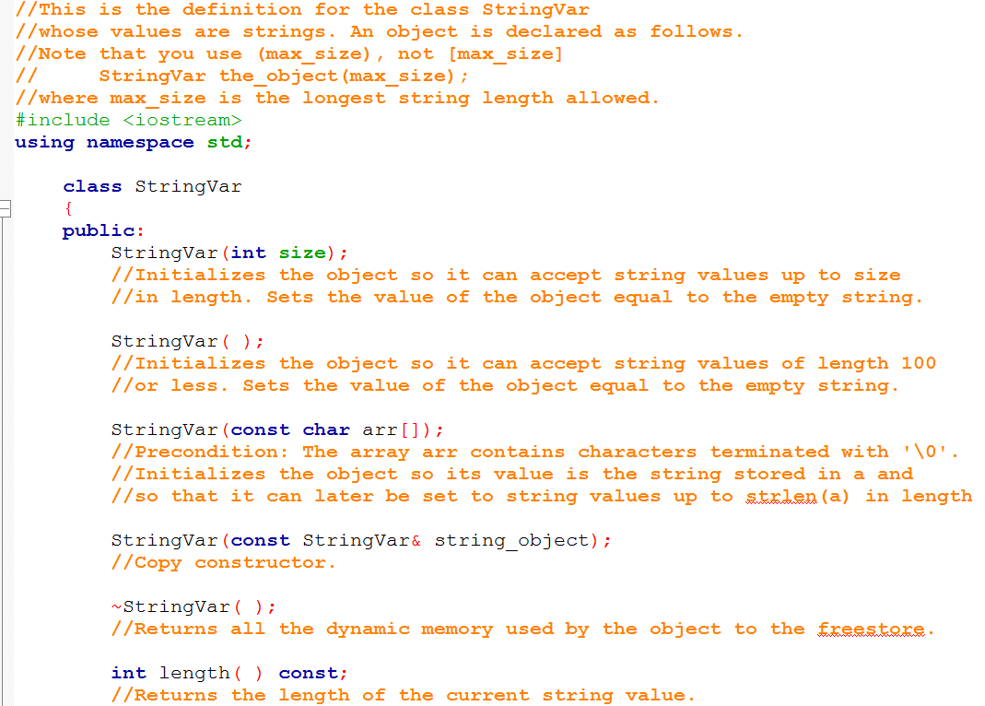
The StringVar Interface

Slide 25
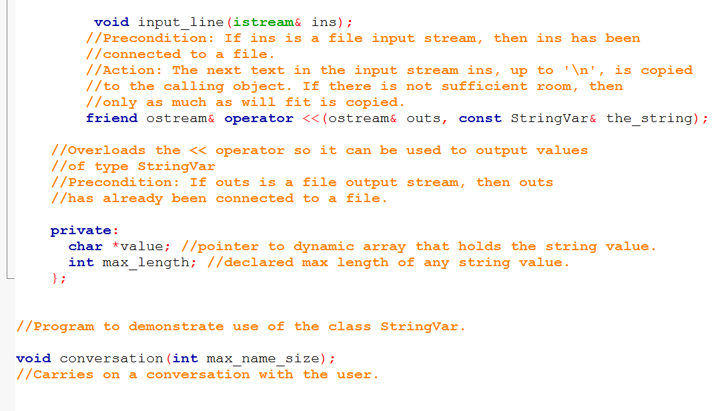
The StringVar Interface

Slide 26
The StringVar Program
Using the StringVar interface, we can write a program using the StringVar class
The program uses function conversation to
Create two StringVar objects, your_name and our_name
your_name can contain any string max_name_size or shorter in length
our_name is initialized to "Borg" and can have any string of 4 or less characters

Slide 27
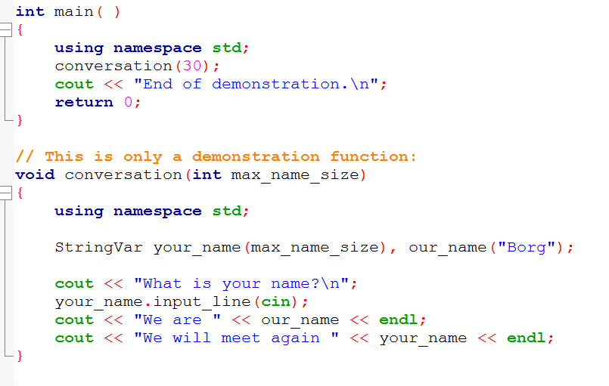
The StringVar Program

Slide 28
The StringVar Implementation
StringVar uses a dynamic array to store its string
StringVar constructors call new to create the dynamic array for member variable value
'\0' is used to terminate the string
The size of the array is not determined until the array is declared
Constructor arguments determine the size
W i l l w a s h e r e \0

Slide 29
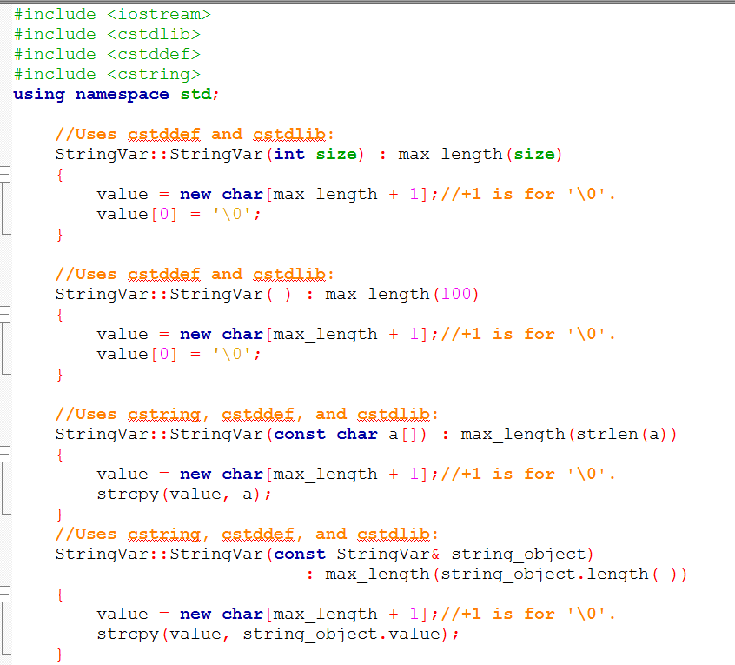
The StringVar Implementation

Slide 30
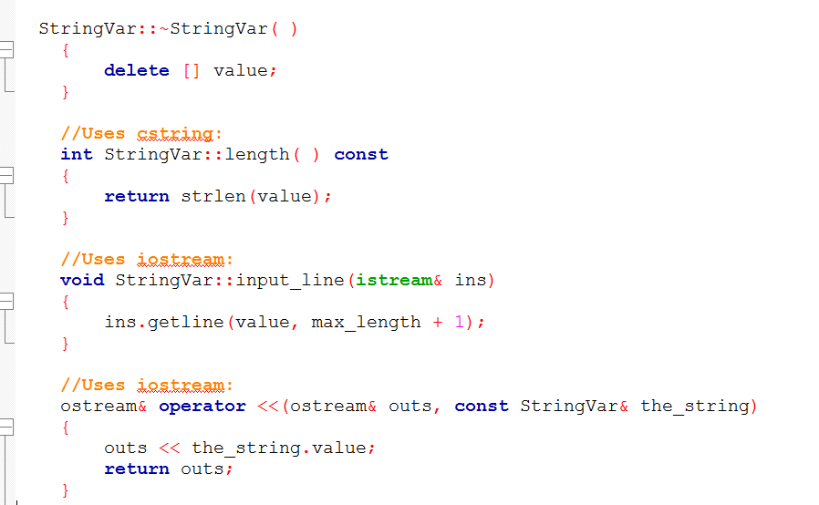
The StringVar Implementation

Slide 31
Dynamic Variables
Dynamic variables do not "go away" unless delete is called
Even if a local pointer variable goes away at the end of a function, the dynamic variable it pointed to remains unless delete is called
A user of the SringVar class could not know that a dynamic array is a member of the class, so could not be expected to call delete when finished with a StringVar object

Slide 32
~StringVar
The destructor in the StringVar class must call delete [ ] to return the memory of any dynamic variables to the freestore
Example: StringVar::~StringVar( ) { delete [ ] value; }

Slide 33
Pointers as Call-by-Value Parameters
Using pointers as call-by-value parameters yields results you might not expect
Remember that parameters are local variables
No change to the parameter should cause a change to the argument
The value of the parameter is set to the value of the argument (an address is stored in a pointer variable)
The argument and the parameter hold the same address
If the parameter is used to change the value pointed to, this is the same value pointed to by the argument!

Slide 34
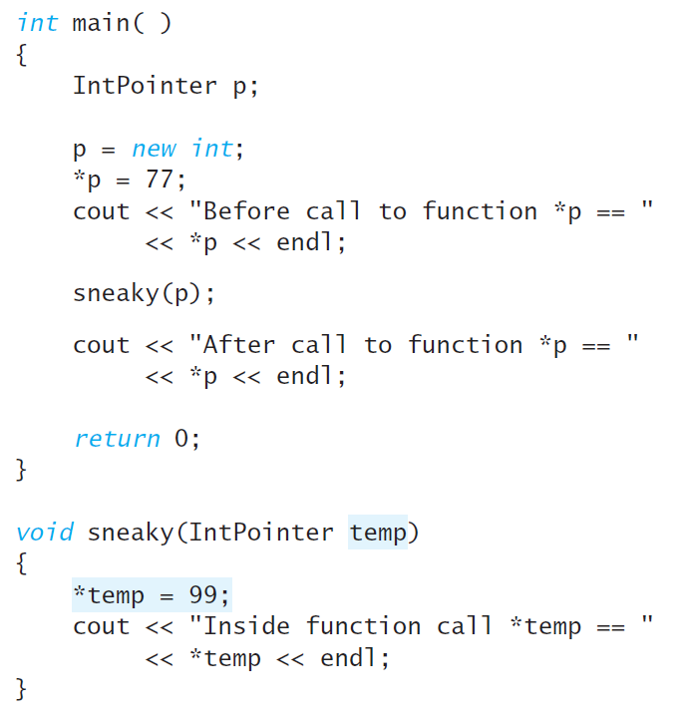
Pointers as Call-by-Value Parameters

Slide 35
Pointers as Call-by-Value Parameters
temp is an address, like FF00A8, because it is a pointer. When we dereferenced it changed the value of where the address was pointing, and that was p.

Slide 36
Copy Constructors
The problem with using call-by-value parameters with pointer variables is solved by the copy constructor.
A copy constructor is a constructor with one parameter of the same type as the class
The parameter is a call-by-reference parameter
The parameter is usually a constant parameter
The constructor creates a complete, independent copy of its argument

Slide 37
StringVar Copy Constructor
This code for the StringVar copy constructor
Creates a new dynamic array for a copy of the argument
Making a new copy, protects the original from changes
StringVar::StringVar(const StringVar &string_object) : max_length(string_object.length()) { value = new char[max_length+ 1]; strcpy(value, string_object.value); }

Slide 38
The Need For a Copy Constructor
This code (assuming no copy constructor) illustrates the need for a copy constructor
void show_string(StringVar the_string) { …} StringVar greeting("Hello"); show_string(greeting); cout << greeting << endl;
When function show_string is called, greeting is copied into the_string
the_string.value is set equal to greeting.value

Slide 39
The Need For a Copy Constructor (cont.)
Since greeting.value and the_string.value are pointers, they now point to the same dynamic array
"Hello"
greeting.value
the_string.value

Slide 40
The Need For a Copy Constructor (cont.)
When show_string ends, the destructor for the_string executes, returning the dynamic array pointed to by the_string.value to the freestore
greeting.value now points to memory that has been given back to the freestore!
Undefined
greeting.value
the_string.value

Slide 41
The Need For a Copy Constructor (cont.)
Two problems now exist for object greeting
Attempting to output greeting.value is likely to produce an error
In some instances all could go OK
When greeting goes out of scope, its destructor will be called
Calling a destructor for the same location twice is likely to produce a system crashing error

Slide 42
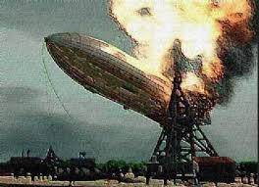
The Need For a Copy Constructor (cont.)

Slide 43
Copy Constructor Demonstration
Using the same example, but with a copy constructor defined
greeting.value and the_string.value point to different locations in memory
"Hello"
"Hello"
greeting.value
the_string.value

Slide 44
Copy Constructor Demonstration (cont.)
When the_string goes out of scope, the destructor is called, returning the_string.value to the freestore
greeting.value still exists and can be accessed or deleted without problems
"Hello"
undefined
greeting.value
the_string.value

Slide 45
When To Include a Copy Constructor
When a class definition involves pointers and dynamically allocated memory using "new", include a copy constructor
Classes that do not involve pointers and dynamically allocated memory do not need copy constructors

Slide 46
The Assignment Operator
Given these declarations: StringVar string(10), string2(20); the statement string1 = string2; is legal
But, since StringVar's member value is a pointer, we have string1.value and string2.value pointing to the same memory location
So if string1 and string2 are both objects of a class that uses dynamic memory allocation, and the class does not have an assignment operator, the pointer(s) to the dynamically declared memory in string2 are copied to the corresponding pointers in string1.

Slide 47
Overloading =
The solution is to overload the assignment operator = so it works for StringVar
operator = is overloaded as a member function
Example: operator = declaration void operator=(const StringVar &right_side);
Right_side is the argument from the right side of the = operator

Slide 48
Definition of =
The definition of = for StringVar could be:
void StringVar::operator= (const StringVar &right_side) { int new_length = strlen(right_side.value); if (( new_length) > max_length) new_length = max_length; for(int i = 0; i < new_length; i++) value[i] = right_side.value[i]; value[new_length] = '\0'; }

Slide 49
Problems with =
The definition of operator = has a problem
Usually we want a copy of the right hand argument regardless of its size
To do this, we need to delete the dynamic array in the left hand argument and allocate a new array large enough for the right hand side's dynamic array
The next slide shows this (buggy) attempt at overloading the assignment operator

Slide 50
Another Attempt at =
void StringVar::operator= (const StringVar& right_side) { delete [ ] value; int new_length = strlen(right_side.value); max_length = new_length; value = new char[max_length + 1]; for(int i = 0; i < new_length; i++) value[i] = right_side.value[i]; value[new_length] = '\0'; }

Slide 51
A New Problem With =
The new definition of operator = has a problem
What happens if we happen to have the same object on each side of the assignment operator? my_string = my_string;
This version of operator = first deletes the dynamic array in the left hand argument.
Since the objects are the same object, there is no longer an array to copy from the right hand side!

Slide 52
A New Problem With =

Slide 53
A Better = Operator
void StringVar::operator = (const StringVar& right_side) { int new_length = strlen(right_side.value); if (new_length > max_length)//delete value only { // if more space delete [ ] value; // is needed max_length = new_length; value = new char[max_length + 1]; } for (int I = 0; i< new_length; i++) value[i] = right_side.value[i]; value[new_length] = '\0'; }

Slide 54
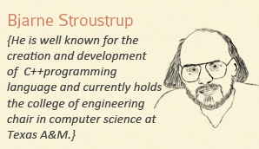
Auto pointer was deprecated in C++11 because it wasn’t so smart

Slide 55
References
Slide contributions include:
Walter Savitch, Problem solving with C++ (9th Edition). Addison-Wesley Longman Publishing Co., Inc. Boston, MA, USA ©2015
Gaddis, Starting Out with C++: From Control Structures through Objects, (8th Ed.) , Addison-Wesley Longman Publishing Co., Inc. Boston, MA, USA ©2015
Bjarne Stroustrup, The C++ Programming Language, 3rd Edition, Addison-Wesley Longman Publishing Co., Inc. Boston, MA, USA ©2007
Herb Sutter, Andrei Alexandrescu, C++ coding standards : 101 rules, guidelines, and best practices, Copyright © 2005 Pearson Education, Inc.
Paul Deitel & Harvey Deitel, C++ How to Program, (7th Ed.) © 2010 by Pearson Education, Inc.
Upper Saddle River, New Jersey 07458
Scott Meyers, Effective Modern C++. Copyright © 2015 (O’Reilly) , 978-1-491-90399-5.
Andrew Koenig and Barbara E. Moo, Accelerated C++ Practical Programming by Example,
Addison-Wesley, 2000 ISBN 0-201-70353-X

Slide 56
References
Slide contributions include:
Frank M. Carrano. Data Abstraction & Problem Solving with C++ (5th Edition)
Addison-Wesley Longman Publishing Co., Inc. Boston, MA, USA ©2006
TutorialsPoint - http://www.tutorialspoint.com/cplusplus/
Cplusplus.com - http://www.cplusplus.com/doc/tutorial/

